Slide 1


NTUA Top Tagger Tag & Probe methodology

Slide 2
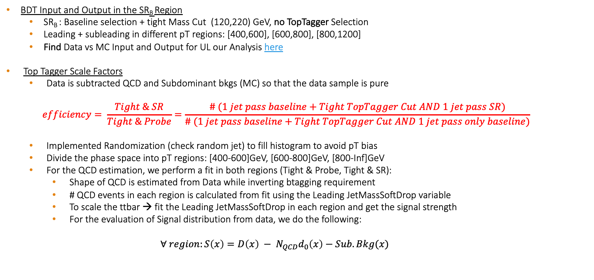
Overview
BDT Input and Output in the SR_{B} Region
SR_{B} : Baseline selection + tight Mass Cut (120,220) GeV, no TopTagger Selection
Leading + subleading in different pT regions: [400,600], [600,800], [800,1200]
Find Data vs MC Input and Output for UL our Analysis here
Top Tagger Scale Factors
Data is subtracted QCD and Subdominant bkgs (MC) so that the data sample is pure
$$efficiency= \frac{Tight \& SR}{Tight \& Probe}=\frac{\# (1 jet pass baseline+Tight TopTagger Cut AND 1 jet pass SR)}{\# (1 jet pass baseline+Tight TopTagger Cut AND 1 jet pass only baseline)}$$
Implemented Randomization (check random jet) to fill histogram to avoid pT bias
Divide the phase space into pT regions: [400-600]GeV, [600-800]GeV, [800-Inf]GeV
For the QCD estimation, we perform a fit in both regions (Tight & Probe, Tight & SR):
Shape of QCD is estimated from Data while inverting btagging requirement
# QCD events in each region is calculated from fit using the Leading JetMassSoftDrop variable
To scale the ttbar → fit the Leading JetMassSoftDrop in each region and get the signal strength
For the evaluation of Signal distribution from data, we do the following:
$$∀ region:S\left(x\right)={D\left(x\right) − N}_{QCD}d_{0}\left(x\right)−Sub.Bkg(x)$$

Slide 3
Signal Selection
Control Region Selection
Variables | Selected Cut
pT leading jets | > 450 GeV
pT 2nd leading jets | > 400 GeV
Njets | > 1
N leptons | = 0
|eta| (both leading jets) | < 2.4
mJJ | > 1000 GeV
jetMassSoftDrop (only for fit) | (50,300) GeV
Top Tagger | > 0.2
B tagging (2 btagged jets) | > Medium WP
Signal Trigger
Variables | Selected Cut
pT leading jets | > 450 GeV
pT 2nd leading jets | > 400 GeV
N leptons | = 0
|eta| (both leading jets) | < 2.4
mJJ | > 1000 GeV
jetMassSoftDrop (only for fit) | (50,300) GeV
Top Tagger | > 0.2
B tagging (0 btagged jets) | < Medium WP
Control Trigger

Slide 4
TagAndProbe Efficiency per Pt region (2016_preVFP)
Efficiency--
eff data: 0.757 ± 0.058
eff ttbar: 0.788 ± (stat) 0.009 ± (stat + systematic) 0.01
-----------
Efficiency per Pt region
eff data pT[400-600]: 0.746 ± 0.075
eff ttbar pT[400-600]: 0.792 ± (stat) 0.012 ± (stat + systematic) 0.014
-----------
eff data pT[600-800]: 0.76 ± 0.101
eff ttbar pT[600-800]: 0.786 ± (stat) 0.014 ± (stat + systematic) 0.016
-----------
eff data pT[800-Inf]: 0.824 ± 0.197698
eff ttbar pT[800-Inf]: 0.765 ± (stat) 0.037 ± (stat + systematic) 0.052
pT [400,600]GeV
pT [600,800]GeV
pT [800,Inf]GeV

Slide 5
TagAndProbe Efficiency per Pt region (2016_postVFP)
Efficiency--
eff data: 0.79 ± 0.052
eff ttbar: 0.781 ± (stat) 0.008 ± (stat + systematic) 0.009
-----------
Efficiency per Pt region
eff data pT[400-600]: 0.77 ± 0.068
eff ttbar pT[400-600]: 0.791 ± (stat) 0.011 ± (stat + systematic) 0.013
-----------
eff data pT[600-800]: 0.809 ± 0.085
eff ttbar pT[600-800]: 0.772 ± (stat) 0.012 ± (stat + systematic) 0.013
-----------
eff data pT[800-Inf]: 0.861 ± 0.259
eff ttbar pT[800-Inf]: 0.758 ± (stat) 0.034 ± (stat + systematic) 0.037
pT [400,600]GeV
pT [600,800]GeV
pT [800,Inf]GeV

Slide 6
TagAndProbe Efficiency per Pt region(2017)
Efficiency--
eff data: 0.814 ± 0.033
eff ttbar: 0.859 ± (stat) 0.006 ± (stat + systematic) 0.007
-----------
Efficiency per Pt region
eff data pT[400-600]: 0.81 ± 0.044
eff ttbar pT[400-600]: 0.86 ± (stat) 0.008 ± (stat + systematic) 0.01
-----------
eff data pT[600-800]: 0.823 ± 0.051
eff ttbar pT[600-800]: 0.859 ± (stat) 0.01 ± (stat + systematic) 0.011
-----------
eff data pT[800-Inf]: 0.793 ± 0.132
eff ttbar pT[800-Inf]: 0.845 ± (stat) 0.029 ± (stat + systematic) 0.032
pT [400,600]GeV
pT [600,800]GeV
pT [800,Inf]GeV

Slide 7
TagAndProbe Efficiency per Pt region(2018)
Efficiency--
eff data: 0.792 ± 0.03
eff ttbar: 0.815 ± (stat) 0.005 ± (stat + systematic) 0.006
-----------
Efficiency per Pt region
eff data pT[400-600]: 0.785 ± 0.043
eff ttbar pT[400-600]: 0.814 ± (stat) 0.007 ± (stat + systematic) 0.008
-----------
eff data pT[600-800]: 0.81 ± 0.044
eff ttbar pT[600-800]: 0.819 ± (stat) 0.008 ± (stat + systematic) 0.012
-----------
eff data pT[800-Inf]: 0.753 ± 0.11
eff ttbar pT[800-Inf]: 0.802 ± (stat) 0.024 ± (stat + systematic) 0.029
pT [400,600]GeV
pT [600,800]GeV
pT [800,Inf]GeV

